Slide 1
Simulations
Year 12 Essentials

Slide 2
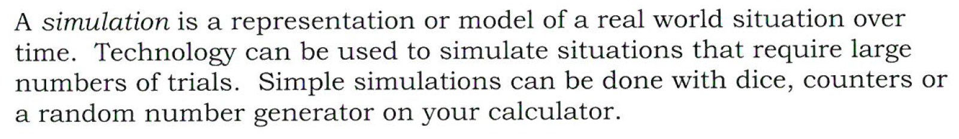
24
7
30
Simulations
Date
EQ – How do we run simulations?
What is a Simulation?

Slide 3
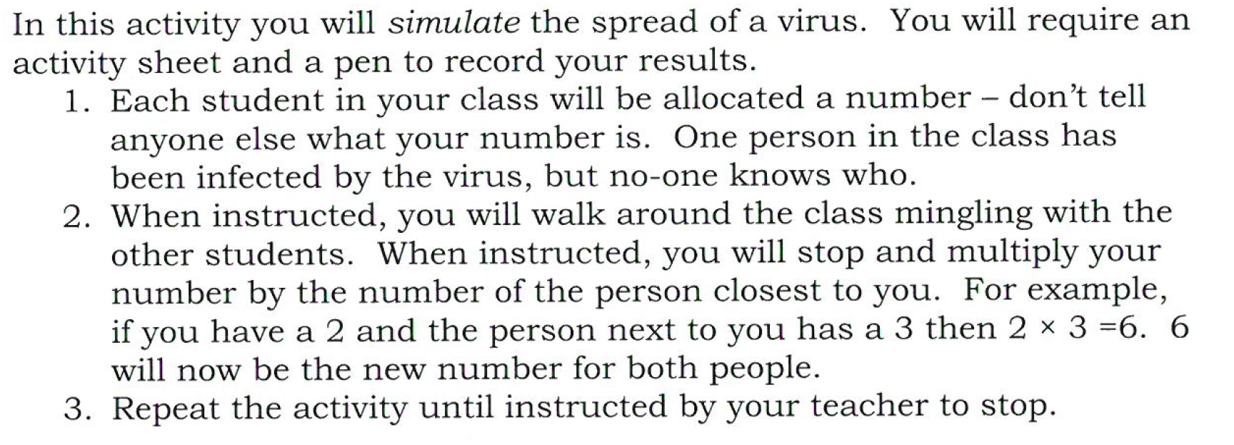
Simulation Activity

Slide 4


Slide 5
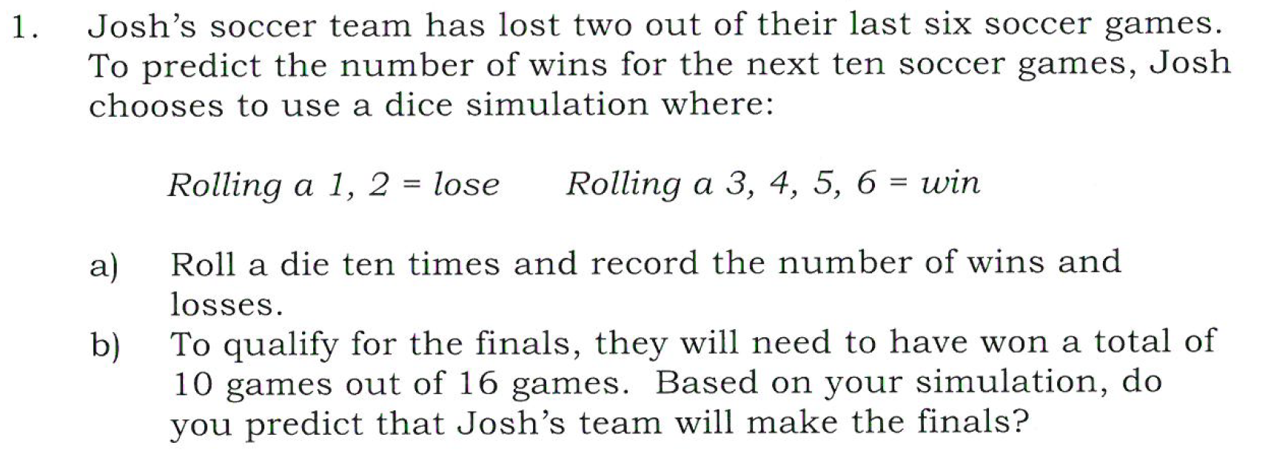
Task

Slide 6
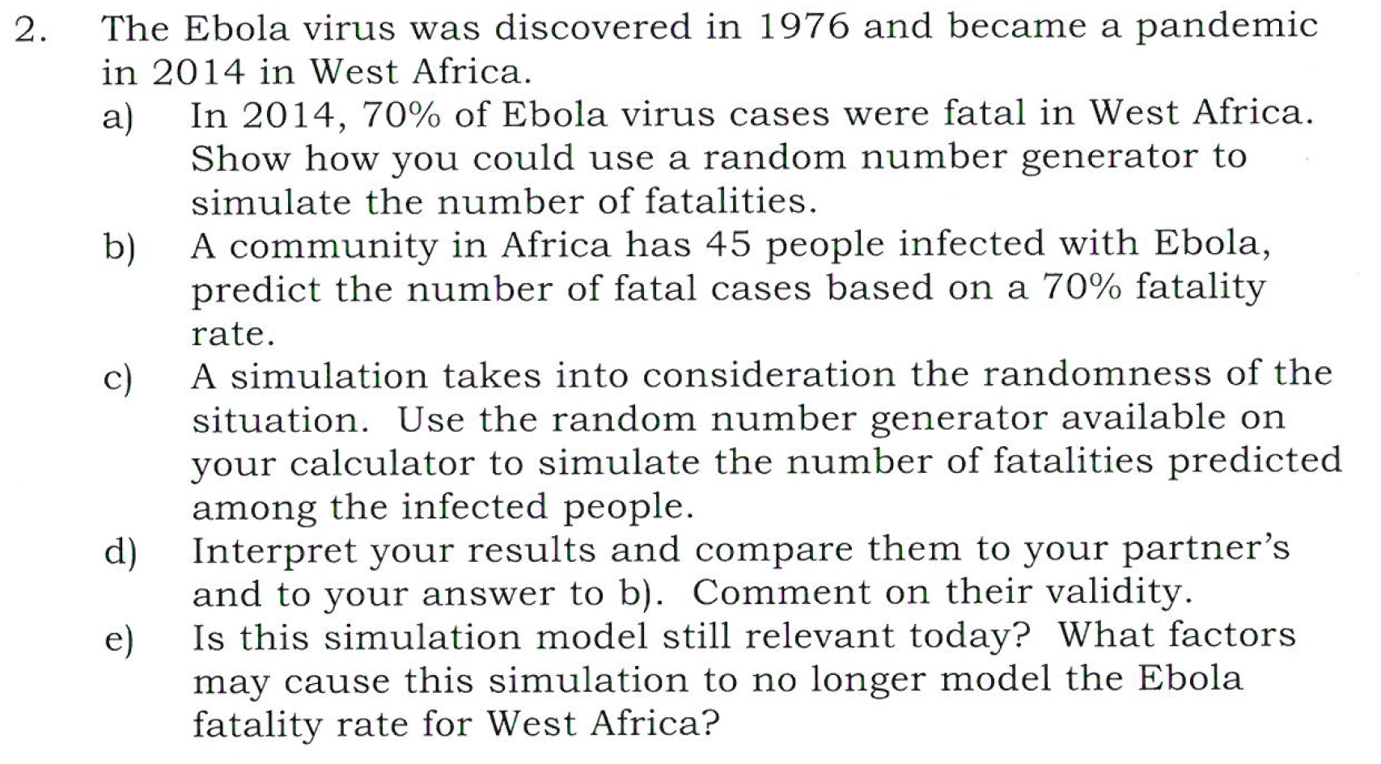
Task
https://www.google.com.au/search?q=random+number+generator&ie=&oe=

Slide 7
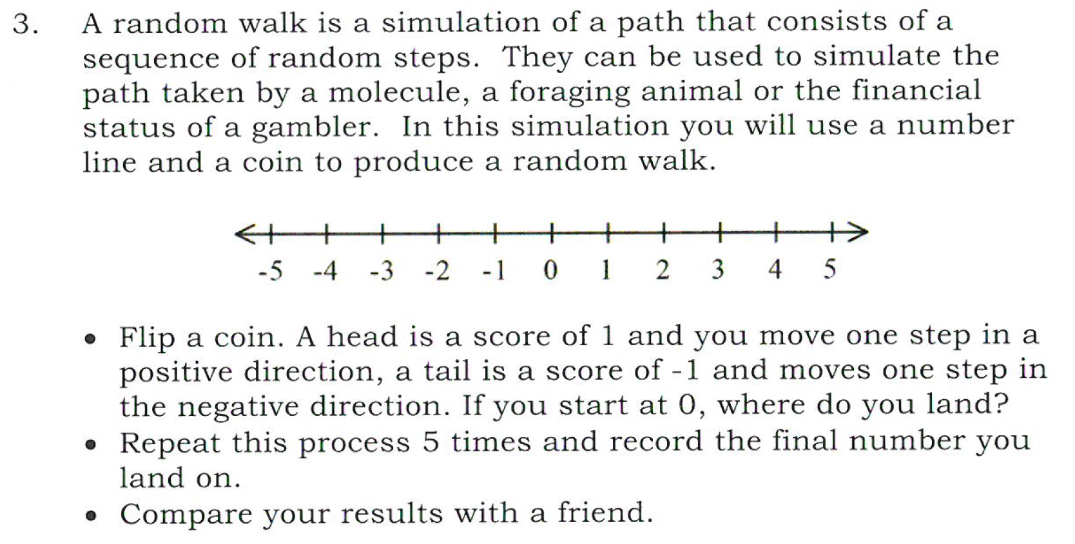
Task

Slide 8
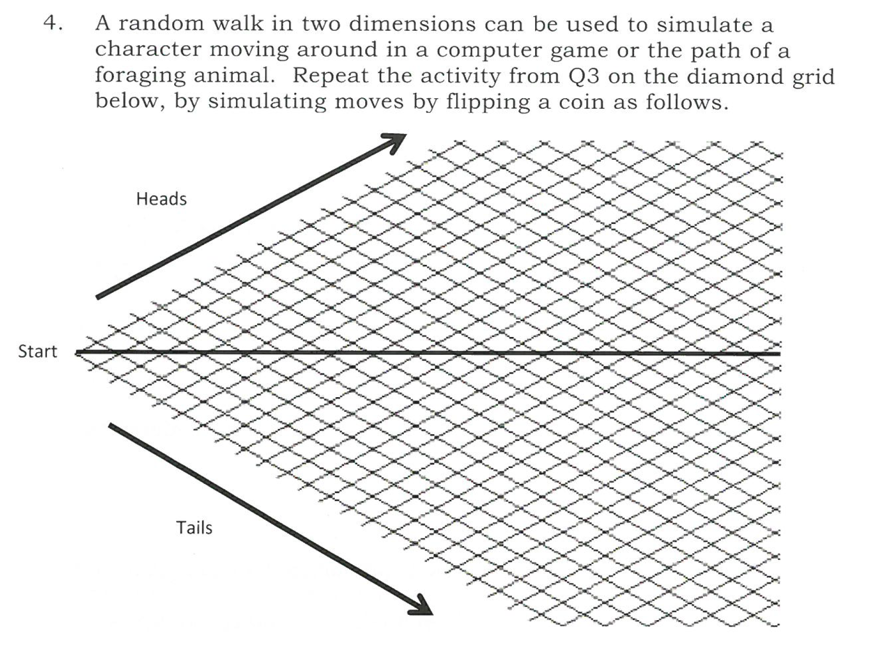
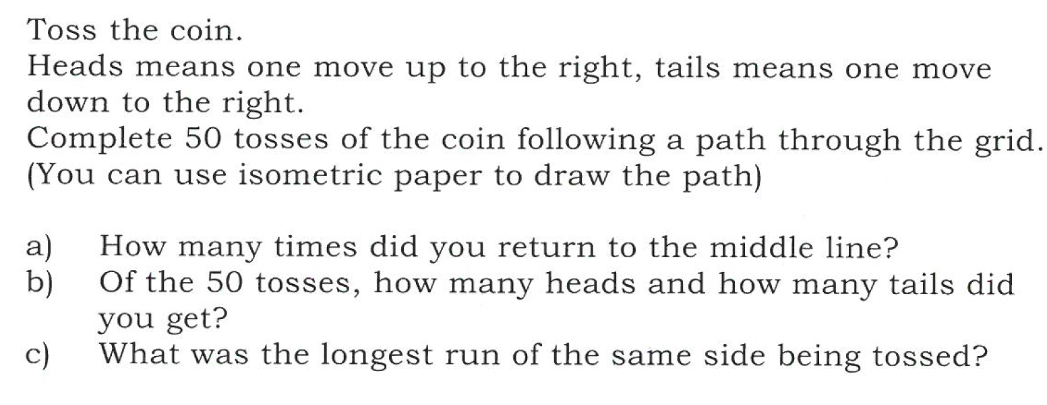
Task

